Slide 1
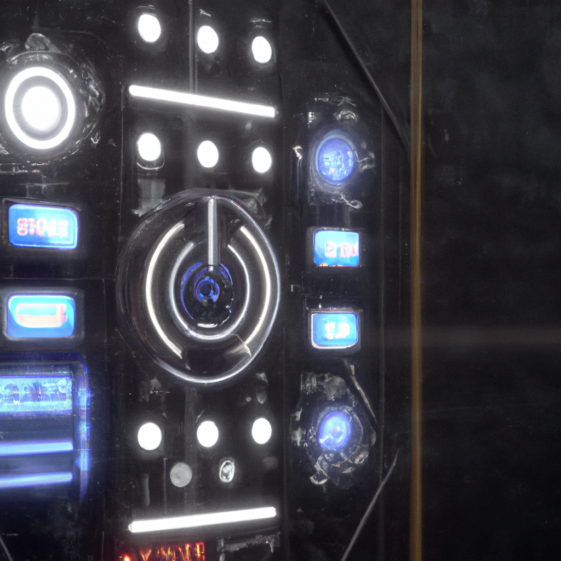
Voice control esp32 smart switch board

Slide 2
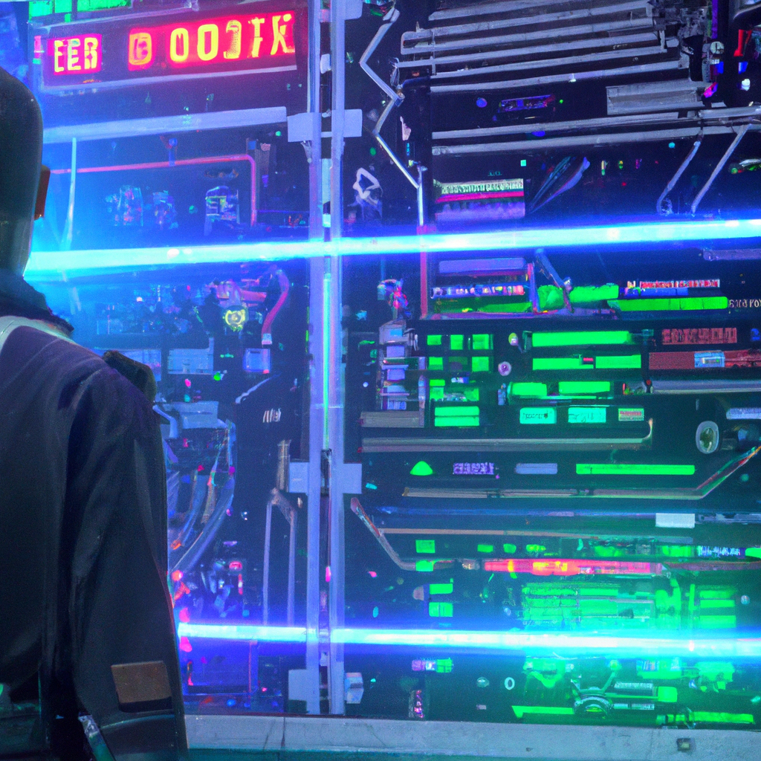
Introduction
Smart homes have become increasingly popular over the past few years. They offer a level of convenience and control that was previously unavailable. Our project is designed to take smart home automation to the next level.

Slide 3
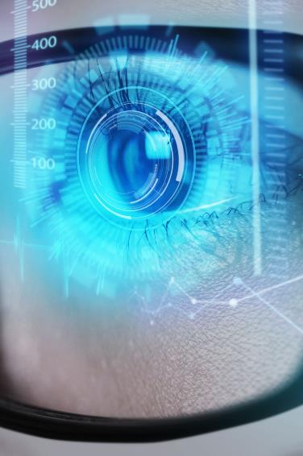
technologies
Microcontroller
IOT
API
Microcontroller technology is the concept of creating a small computer on a single chip that can perform various tasks in an embedded system. A microcontroller typically consists of a processor, memory, and input/output peripherals that can communicate with other devices and sensors. Microcontrollers are used in many applications, such as automotive, medical, industrial, and consumer electronics
The technology of IoT is the concept of connecting various devices and objects to a network that can exchange data and information without human intervention. IoT devices can have sensors, software, processing ability and other technologies that enable the
The technology of API is the concept of creating a set of rules and protocols that enable different software components to communicate with each other. API stands for Application Programming Interface, and it defines how a client application can request and receive data from a server application. There are different types of APIs, such as SOAP, RPC, WebSocket, and REST. REST APIs are the most common and flexible ones, and they use HTTP methods like GET, PUT, DELETE, etc.

Slide 4
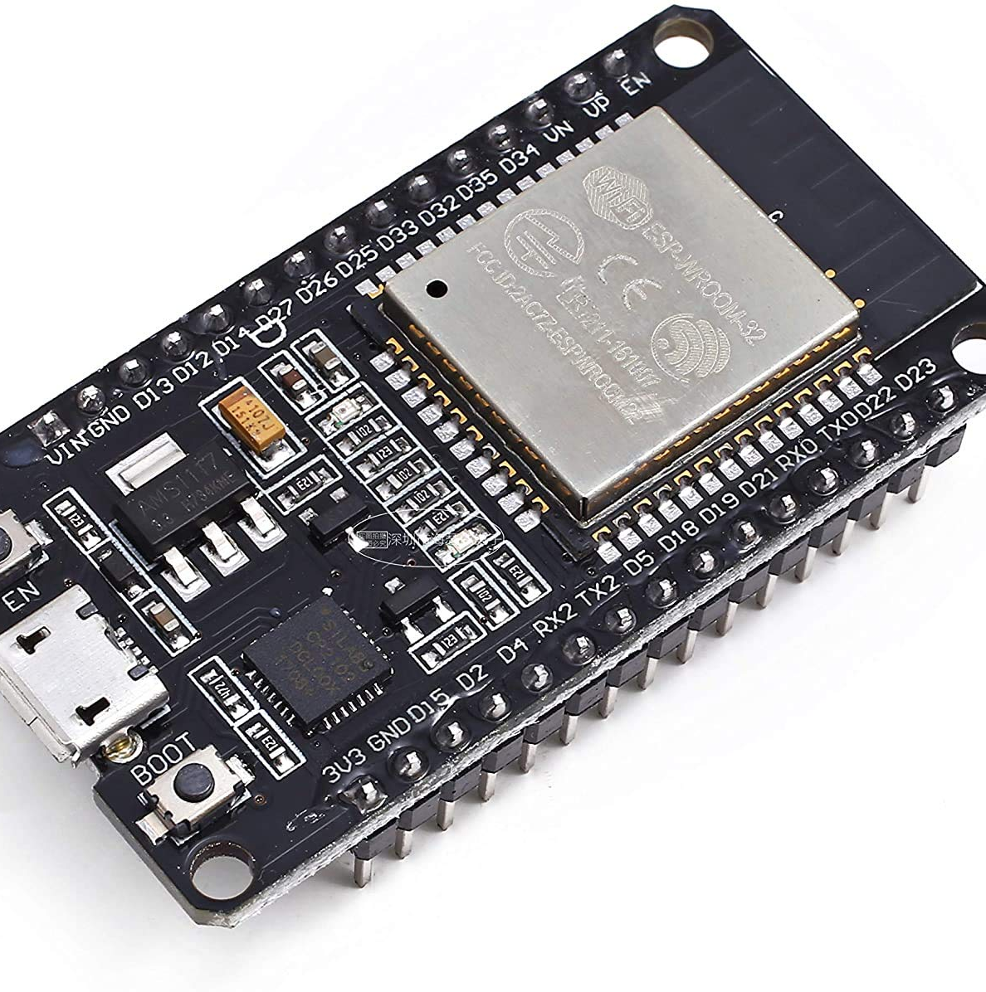
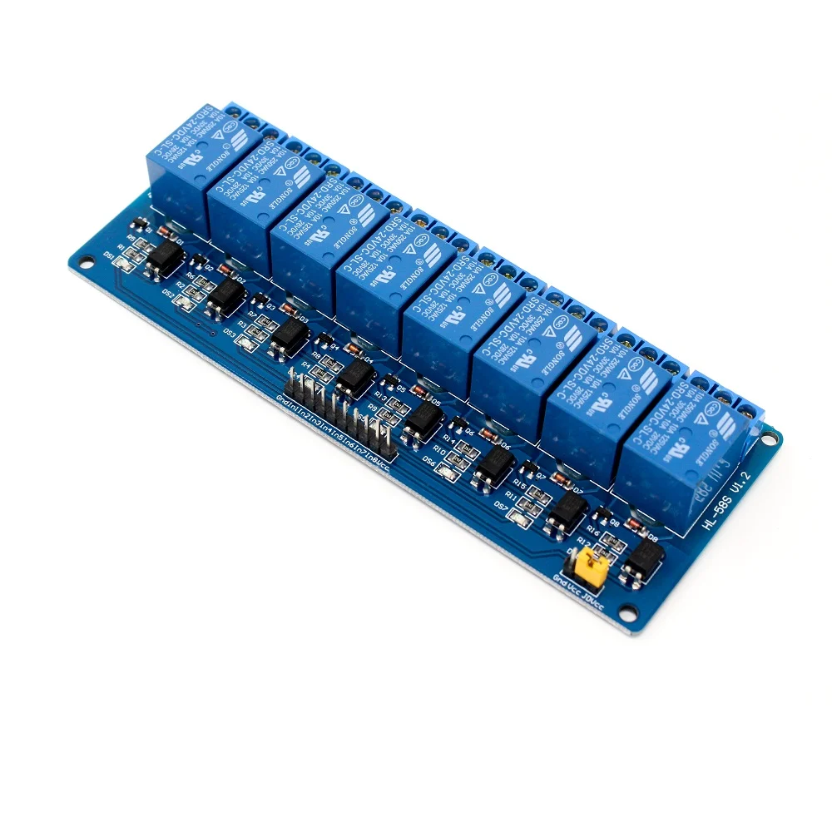
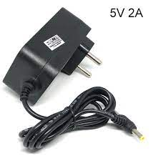
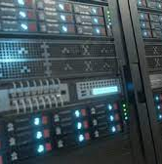
Tools
ESP-32​​
8 channel relay
5V DC Adapter
server
We used this to get Wi-Fi access for IoT
To control ac supply
To give power supply to give power supply to our to our home Automation
For making thing operate from anywhere and Used the potential of IoT

Slide 5
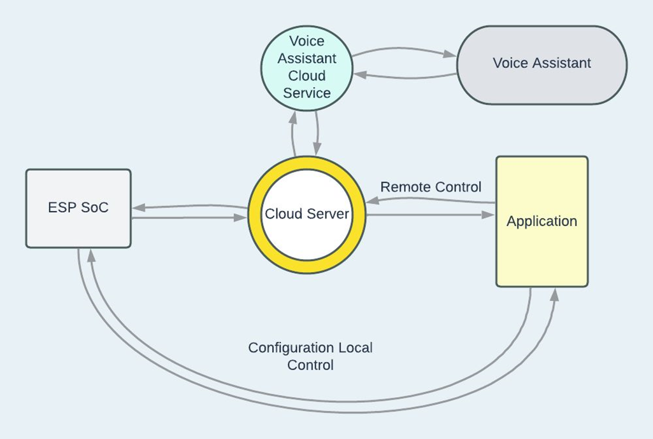
FLOW Chart of our project

Slide 6

Showcasing the experiment

Slide 7
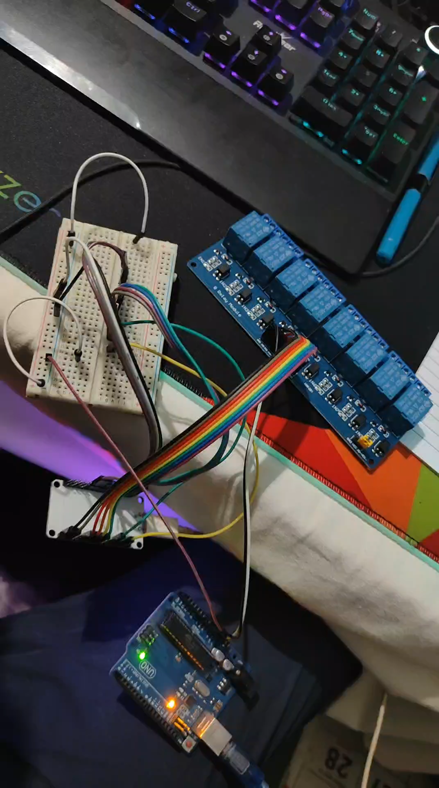
Video 1
Video​ testing
In this Video we are testing the automation with the help of Alexa and how the automation works without server or on local network discovery mode.

Slide 8
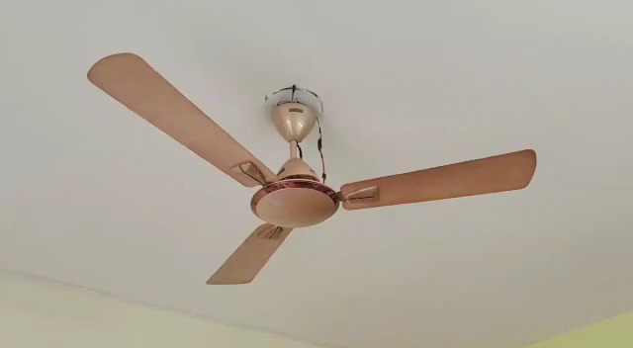
Video 2
In this Video we are testing the automation with the help of Alexa and checking the fan regulation at different stages with the help of voice command​

Slide 9

Result And Analysis
The results of a voice-controlled smart home automation project using ESP32 and Alexa/Google Home can be quite impressive. With this system in place, users can control various appliances and devices in their homes using voice commands, making it a more convenient and efficient way to manage their homes.
Overall, the results of the project were very promising, demonstrating the potential for voice-controlled smart home automation systems to provide a more convenient and efficient way to manage homes. However, there were also some limitations and challenges encountered during the project, such as connectivity issues and technical challenges, which will need to be addressed in future iterations of the system.

Slide 10
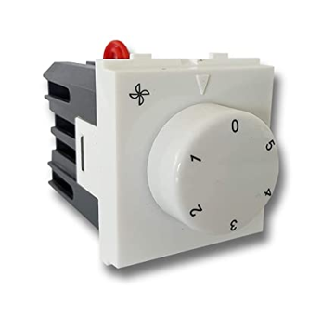
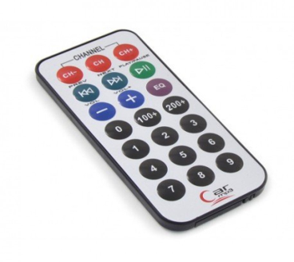
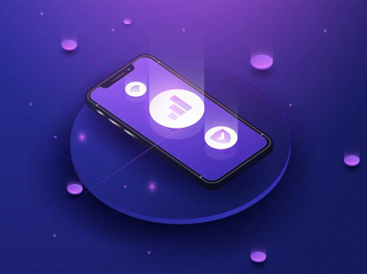
Further Plan of Action
Fan regulator
IR remote Support
Mobile App
Addition of IR remote support for enabling offline and manual control.
Adding mobile application support that does not depend on APIs like google and Alexa.
Implementing manual fan regulation option with SmartThings.

Slide 11
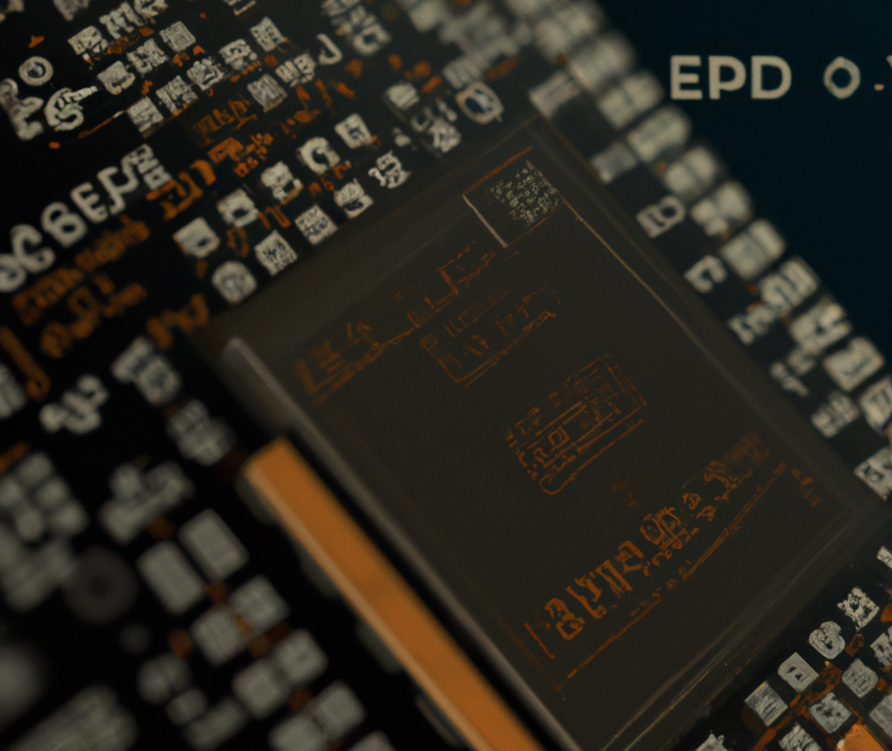
Thank you

